Slide 1
Lesson Overview
Introduce the first activity for today (2min)- revising the criteria list. Remind them that they had to use the list during the gallery walk and now that they have tried to use it they may finds ways in which it was not working for them—now is the time to revise.
Group discussion (5min) – In groups have them discuss suggestions for revising the list
Class discussion (15 min)- work with students’ ideas to revise and deepen the list (see notes on relevant slide)- they should be filling out the worksheet
What we figured out and what we still don’t know (10min)- have a discussion about what we know to date and what we still need to find out.
MEME- (17min) – have groups go on MEME and fix their models based on comments they received and the discussion
Total time- 50 mins.
Notes:
Materials: class criteria list, blank chart paper to make new criteria list, HO3, MEME (computers)
Content learning goals (CLG) and Things we figure out:
Decomposers use up air when eating dead matter (in this case dead algae)
Decomposers grow and multiply
Decomposers breathe air just like we do (dissolved air in water decreases)
Epistemic learning goals (ELG):
Simulations can be used to test hypotheses.
Evidence and simulations can be used together to develop and test hypotheses.
If simulations do not fit the empirical evidence, their assumptions can be changed.
Carefully aligning evidence & simulations with models makes models better.
Thoughtful peer critique and uptake of critique makes models better.

Slide 2
LESSON 3 - DAY 6

Slide 3


Model Criteria
What are your group’s suggestions for improving our criteria list? 2 suggestions
Think about reasons: why is this criterion important?
Do you have an idea for adding criteria that is not on the list?
Do you have an idea for revising or clarifying a criteria?
Should we remove any criteria?
Notes:
Tell students we need to revise our list. We have used it to make models, we have used it to critique models (gallery walk). We now know what works and what doesn’t work with our list. Maybe there is an important criterion missing, maybe we need to provide more details for some of the criteria (deepen them). Based on their experience using the list they need t work in groups and suggest at least 2 changes. These can be ideas to add, or change criteria

Slide 4
Model Criteria
What are your group’s suggestions for improving our criteria list?
Think about reasons: why is this criterion important?
Do you have an idea for adding criteria that is not on the list?
Do you have an idea for revising or clarifying a criteria?
Should we remove any criteria?
Insert photo of your class’s criteria list here
Write your ideas for improvement on the handout. At least 2 suggestions!
Notes:
Tell students that we will be revising the criteria list today and here is their original list
They need to write suggestions for revisions on their handout

Slide 5

Model Criteria
As a class, let’s revise criteria list
Remember to give reasons!
What are your group’s suggestions for improving our criteria list?
Do you have an idea for adding criteria that is not on the list?
Do you have an idea for revising or clarifying a criteria?
Should we remove any criteria?
Notes:
Instruction
Its now time to revise the list. We used it, we made models, we now have a better idea about what works and what doesn’t with this list.
Have students share ideas for revision.
Try to move away from labels and just organization– focus more on :
having a mechanism
having a complete explanation (not just an explanation)
Making sure we show HOW evidence is related– using the ++ + and XXX
Making sure we show what part of the model is supported
Supporting both mechanisms and components (not just components)
Kids may have additional suggestions– make sure the class agrees to any additions, changes, removals. (removal may happen if thy are REALLY good at something and don’t need reminding…. Then we remove but they are still accountable)

Slide 6
Model Criteria
Individually, answer the following question on your handout:
Think about the class criteria list that you made. Which two criteria from the class list are most important? Why do you think so?
Notes:
Instruction 2min
Have students answer this question individually by thinking and writing their responses on the handout. – NO need to discuss.

Slide 7

What have we figured out about decomposers?
Decomposers use up air when breaking down dead matter
Decomposers get energy from breaking down dead matter
After the algae bloomed there was a lot of dead matter all of a sudden
This allowed decomposers to grow and multiply and they used more air
Eventually there was no air for the fish
Notes:
What questions do we still have? SLIDE IS ANIMNATED – what we know appears on click
Ask students what do we know to date from the evidence about DECOMPOSERS (we know a lot of things, but we want to focus on decomposers.
We know the break down dead matter (please use break down language not eating language…they don’t technically ingest the dead matter- they get energy from breaking down dead matter
They use up air when doing that
The algae bloomed and so there was a lot of dead matter (once they started dying) and that allowed for more decomposers
More decomposers means less air and eventually fish died

Slide 8

What questions do you still have?
Why was there so much algae all of a sudden?
What caused this algal bloom?
Notes:
What questions do we still have? SLIDE IS ANIMNATED – questions appear on click
Main questions are – why did the algae bloom ALL OF A SUDDEN?

Slide 9
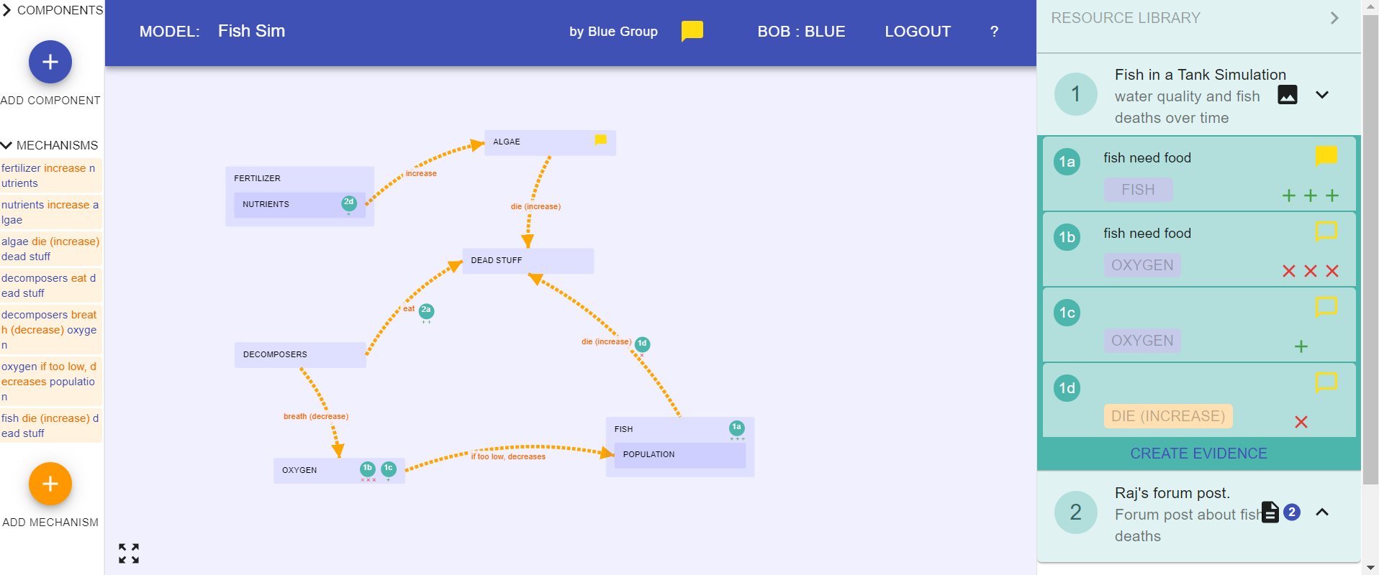







MEME: Update Model
Revise your model based on the comments you received from other groups
Revise it based on what we figured out
Make sure your model meets the new class criteria.
Dead Fish
Notes:
Instruction
Explain that we need to update our models based on the evidence we studied and our discussion just now AND based on comments our peers gave us. So the students should spend pretty much rest of the period working on their MEME models and attending to comments–
fixing their models based on suggestions.
Fixing their models based on the discussion
Model also needs to meet the new and revised criteria!
Materials
Hand out computers.

Slide 10


Evidence Discussion
We can see there are decomposers in the simulation, so this means there must be decomposers in the pond…
Do you agree or disagree?
Notes:
If time permits (unlikely)– have a brief discussion on this question

